Slide 1
Operating system
Review: OS’s big picture now

Slide 2
Review
Sketch of OS
Infinite repetition, 4 components, services for others
Understand the execution first
CPU and controller as special chips which could understand and execute the instructions (together with other parameters)
2 mappings sharing similar scheme
from logic file space (a finite collection of bytes) into linear addressed space (frames, blocks)

Slide 3
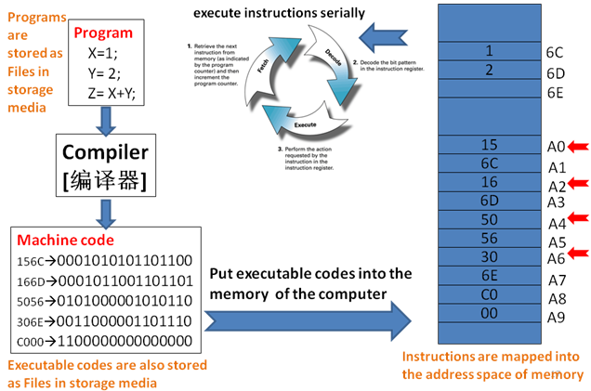
The power of computer systems
To execute programs!

Slide 4
Definition of OS
The software/program which contains a collection of many routines (functions, programs) to support the automatic execution of many cooperated and concurrent programs
Many subtasks should be considered
EMM
Execution: how is your program run?
Mapping 2: locate the program files (instructions and data) in Hdisk
Mapping 1: copy the selected program files (instructions and data) from Hdisk into appropriate regions in MM
GSD: GUI, Security, Distributed

Slide 5
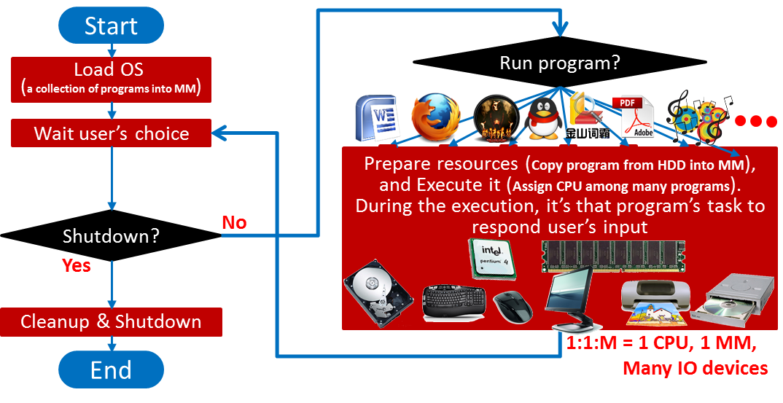
Helpful diagram to understand OS
Infinite repetition controlled by users

Slide 6
The roles of OS
Friendly interface for the users
Files, GUI
Efficient and safe manager for the resources
Storage media
I/O devices
Memory
CPU
User₁
User₂
User₃
User_{n}
Compiler Assembler Text editor … DBMS
System & application programs
Operating system
Computer hardware
Notes:
The hardware—the central processing unit (CPU), the memory, and the input/output (I/O) devices—provides the basic computing resources for the system.
The application programs—such as word processors, spreadsheets, compilers, and Web browsers—define the ways in which these resources are used to solve users’ computing problems.
The operating system controls the hardware and coordinates its use among the various application programs for the various users.

Slide 7
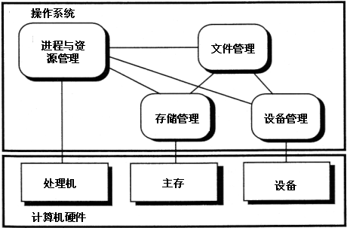
Four fundamental components of modern OS
Operating System
Process Management
File
Management
Memory
Management
Device
Management
CPU
Main Memory
IO Devices
Hardwares

Slide 8
Review
Sketch of OS
Infinite repetition, 4 components, services for others
Understand the execution first
CPU and controller as special chips which could understand and execute the instructions (together with other parameters)
2 mappings share similar scheme
from logic file space (a finite collection of bytes) into linear addressed space (frames, blocks)

Slide 9
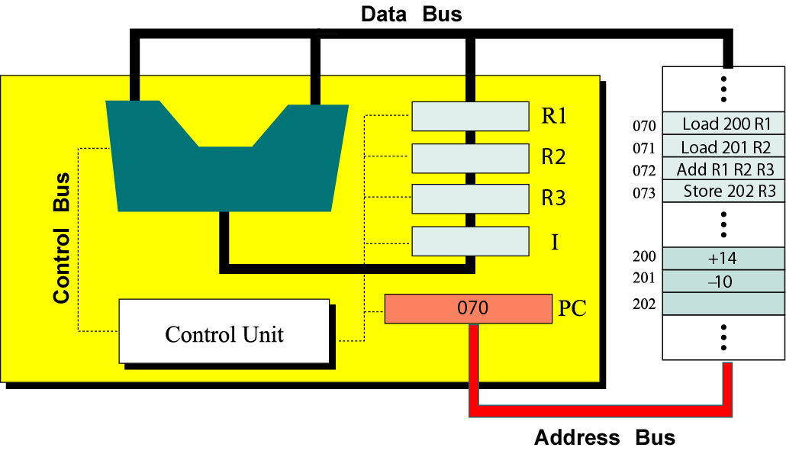
Device Controller Interface
busy done
0 0 idle
0 1 finished
1 0 working
1 1 (undefined)
. . .
busy
done
Error code
. . .
Command
Status
Data 0
Data 1
Logic
Data n-1
In fact, there should be ``status’’ register in CPU too
PPTs from others\cms.dt.uh.edu\chap04.ppt

Slide 10
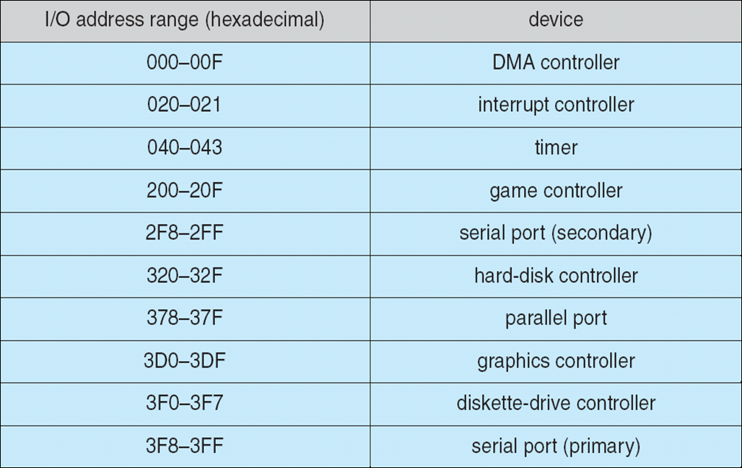
For controller, Instructions and parameters are kept in some MM region – called ports
PPTs.2012\PPTs from others\www.cs.bilkent.edu.tr_~korpe_courses_cs342spring2010\lecture13_io.ppt

Slide 11
CPU
Logic Circuit
Data 0
Data 1
Data n-1
Command

Slide 12
Executing instructions
Instructions are transferred from MM into ``command’’ register one after another
Parameters are also transferred into corresponding registers when needed
The predefined instruction could trigger related electronic circuits to carry out corresponding function
Like addition, multiplication, minus, etc.
Also read/write data from/into some device
I hope you remember these learned from CO course

Slide 13
Executing your program
To run your program, executable file should be gotten usually by compilation
Executable file contains the instructions and data you define when you do programming
Those instructions are transferred to corresponding registers in CPU/controller one after another, …
And you’ve learned how an instruction is decoded and executed
Next is to learn how your executable program is conveyed from hdisk into MM. – 2 mappings

Slide 14


Executing cooperated & concurrent programs
If there is no controlled access to shared data, execution of the processes on these data can interleave⬅ Cooperation.
The results will then depend on the order in which data were modified→ Data Inconsistency ➔ Synchronization
i.e. the results are non-deterministic.
Concurrent processes (or threads) often need to share data (maintained either in shared memory or files) and resources
If there is no proper policy to assign resources among processes, it may result in that all the processes get blocked → Deadlock [死锁]
PPTs from others\flame.cs.dal.ca_~hawkey_3120\May21ProcessSynchronization.ppt

Slide 15


Synchronization – All for lock mechanism
The general layout is of lock mechanism is: do {
acquire lock
critical section
release lock
remainder section
} while (TRUE);

Slide 16
General rules to cope with CS problem using semaphores
Find the types of actors
To determine the processes
Recognize the shared resources between actors
Infer the constraints based on the situations when actors use those shared resources
ME or SCH?
To determine semaphores and their initial values
To determine the code (nested for ME, and scattered for SCH)
Use semaphores to finish those processes

Slide 17


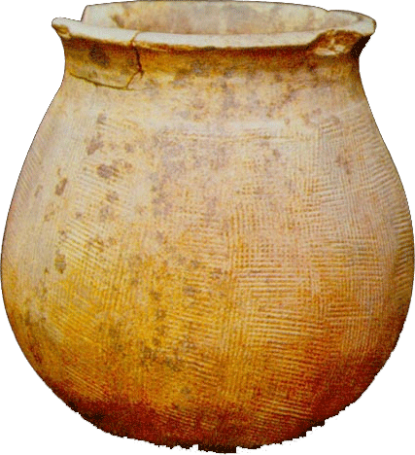



Notes:
Long ago there are many monks in a temple. Some were old and some were young. The young monks were bringing up water from a well. And the old monks can regale on it.
The well was too small to put one bucket every time.
Another vat [大桶] is in the kitchen. It can contain total 10 buckets water. Only one bucket can put in vat and fetch out water.
There are 3 buckets can be used by everyone.

Slide 18
Deadlock
Four necessary conditions
Mutual Exclusion [互斥]
Hold-and-Wait [占有并等待]
No preemption [非抢占]
Circular Wait [循环等待]
Strategies to overcome the deadlock situation
Providing enough resources
Staying Safe
Preventing Deadlocks
Avoiding Deadlocks → Banker’s algorithm!
Living Dangerously
Keep blind (Ostrich[鸵鸟] or Head-in-the-Sand algorithm)
Detect it and Recover from it.

Slide 19
Example 3:
5 processes P₀ through P₄;
3 resource types:
A (10 instances), B (5instances), and C (7 instances)
Snapshot at time T₀:
Allocation Max Available
A B C A B C A B C
P₀ 0 1 0 7 5 3 3 3 2
P₁ 2 0 0 3 2 2
P₂ 3 0 2 9 0 2
P₃ 2 1 1 2 2 2
P₄ 0 0 2 4 3 3
Could the request of P0=<2 1 1> be satisfied or not?

Slide 20
Review
Sketch of OS
Infinite repetition, 4 components, services for others
Understand the execution first
CPU and controller as special chips which could understand and execute the instructions (together with other parameters)
2 mappings share similar scheme
from logic file space (a finite collection of bytes) into linear addressed space (frames, blocks)
Organize the basic storage units first
MM & Hdisk
keep necessary data structures (together with related operations) to carry out the mappings

Slide 21
2 spaces are similar
Usually, your executable program is stored permanently in Hdisk first
To run, it should be copied into
Hdisk and MM could be both conceived as two linear addressed spaces
Each primary storage unit is uniquely numbered.
Usually 1 byte for MM, and sector (512 bytes) for Hdisk
Those primary storage units are further organized into larger semantic regions
(Fixed or Variable) Partitions, Frames for MM
Partitions (logic drives), blocks for Hdisk

Slide 22
Basic tasks of 2 mappings
2 tasks when carrying out mappings (no matter MM or Hdisk)
Space Allocation (Relocation): find enough available regions for your program
Enough available frames for MM, blocks for Hdisk
Address translation (Relationship reserving): convert the logic relationship of records into physical relationship delegated by storing records in connected physical regions
Through the physical addresses of those related regions

Slide 23
 | Mapping 1: File to MM | Mapping 2: File to Hdisk
Space Allocation | Fixed Partition Cut MM into partitions (equal or unequal) in advance Place your program into the target partition Variable partition Allocate MM according to your program Overlay DLL (Dynamic Linking Library) Paging Cut MM and program into same sized regions (frame, page) Paste needed pages into available frames Segmenting Cut program into semantic regions Allocate MM according to needed region | Sector (C.H.S) → Partitions (except MBR) → Block space Since file is usually also cut into pages whose size is same with the block, the allocation of the file into block space is similar as that of paging
Relationship Reserving | To compute physical address of an instruction is based on (starting address of the target region in MM, offset of the instruction in file) | To compute physical address of a record is based on (file handler, offset of the record in file, size of the record)

Slide 24
Review
Sketch of OS
Infinite repetition, 4 components, services for others
Understand the execution first
CPU and controller as special chips which could understand and execute the instructions (together with other parameters)
2 mappings share similar scheme
from logic file space (a finite collection of bytes) into linear addressed space (frames, blocks)
Organize the basic storage units first
keep necessary data structures (together with related operations) to carry out the mappings

Slide 25
Data structures are needed to carry out those related tasks
Available regions
Available partitions for partitioning, Available frames for paging/hybrid, available holes for segmenting, …
Organize sectors into semantic regions first, and Bit-vector, FAT for Hdisk, …
Mapping information from file to target physical regions
Partition table, Page table, Segment table, …
Tree-structured directories + FCBs as File System for Hdisk, …

Slide 26
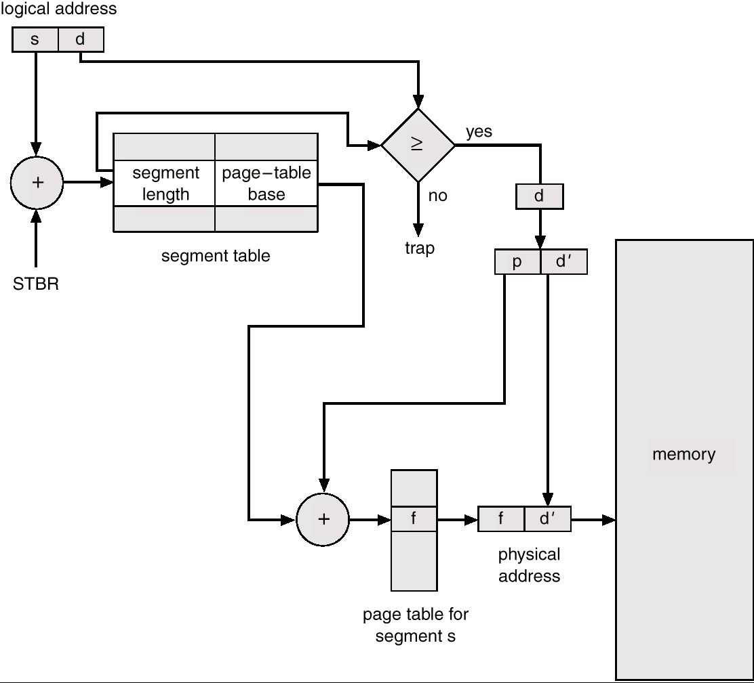
MM – hybrid
Segmenting + Paging
Only segmenting may not practical: we should also consider the size of the segments
Cut MM into frames, program into segments first, and segment is further cut into pages (if necessary)
Some data structures are needed
Available frames,
Mapping information between your and corresponding frames (segment/page table)
Placement & Replacement algorithms
Based on those data structures

Slide 27
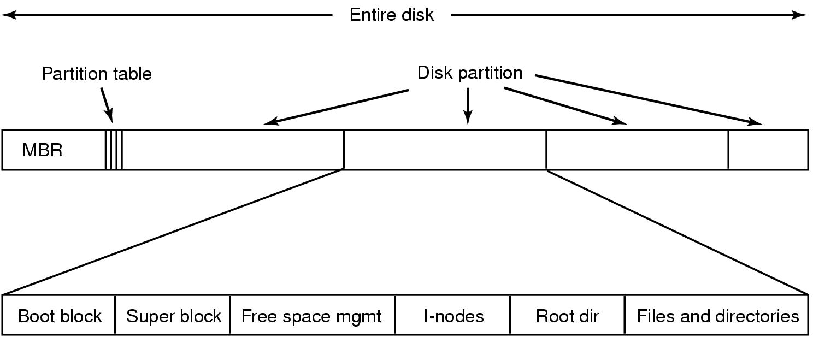
Sector → Partition → Block
Sectors are further reorganized into blocks to convenience the mapping of your file
Usually, the size of a block is 4KB – same as a page/frame
Block 0
Block 1
Block 2
Block K

Slide 28
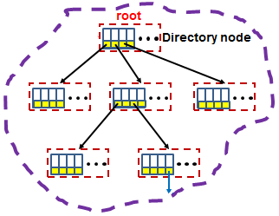
0000 1101 0110
Bitmap
Blocks for files
and directories
Disk → Partitions → Blocks → FS

Slide 29
File System Implementation
Major On-disk Structures (information):
Boot control block contains info needed by system to boot OS from that volume
Volume control block contains volume details
Directory structure organizes the files
Per-file File Control Block (FCB) contains many details about the file
info about a file and its location on disk
partition (volume) starts
Pointers to FCBs
Boot
Control
Block
Volume
Control
Block
Directory
Structure
File Control Blocks
(FCBs)
(filename to FCB mapping)
(i.e. superblock)

